Slide 1
Diabetes Prediction in Pima Indians

Slide 2
Content
Background & Hypothesis Data Source & Description
Data Analysis Feature Selection Model Building & Selection Conclusion

Slide 3
Background & Hypothesis
The Pima Indians of Arizona have the highest recorded prevalence and incidence of non-insulin-dependent diabetes of any geographically-defined population.
The original study involved measuring & collecting various data around the risk factors, prevalence and pathogenesis of Diabetes
Study has been conducted biennially since 1965
The main objective of the study is to determine the risk factors likely to indicate the onset of Diabetes in order to develop specific intervention programs (drugs, diet, exercise e.t.c.
Source: https://www.cabdirect.org/cabdirect/abstract/19921441489

Slide 4
Data Source & Description
Data Source: Kaggle (https://www.kaggle.com/uciml/pima-indians-diabetes-database)
Original Data Description
768 Rows
8 Columns (Features), 1 Classification Column
(1 = Diabetes; 0 = No Diabetes)
All 8 Feature Columns Consist of Continuous Data
Data Dictionary
Pregnancies: Number of times pregnant
Glucose: Plasma glucose concentration
BloodPressure: Diastolic blood pressure (mm Hg)
SkinThickness: Triceps skin fold thickness (mm)
Insulin: 2-Hour serum insulin (mu U/ml)
BMI: Body mass index (weight in kg/(height in m)^2)
DiabetesPedigreeFunction: Diabetes pedigree function
Age: Age (years)
Outcome: Class variable (0 or 1)

Slide 5
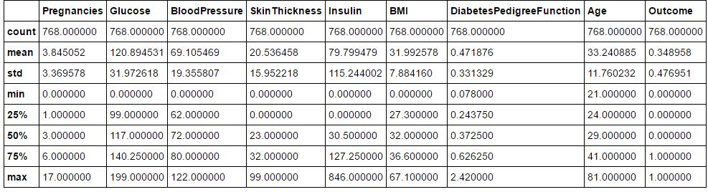
Data Analysis
Analysis Base Table
The Analysis Base Table (ABT) showed that the minimum values for ‘Glucose’, ‘BloodPressure’, ‘SkinThickness’, ‘Insulin’ and ‘BMI’ was 0. This does not make intuitive sense, so all the 0 values for this column was replaced with the mean values for each of the columns
Fig 1: Analysis Base Table (ABT) for Original Data

Slide 6
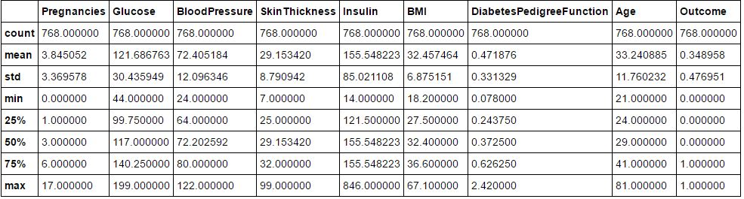
Data Analysis (cont’d)
Fig 2: Analysis Base Table (ABT) After Replacing 0s with Mean Values

Slide 7
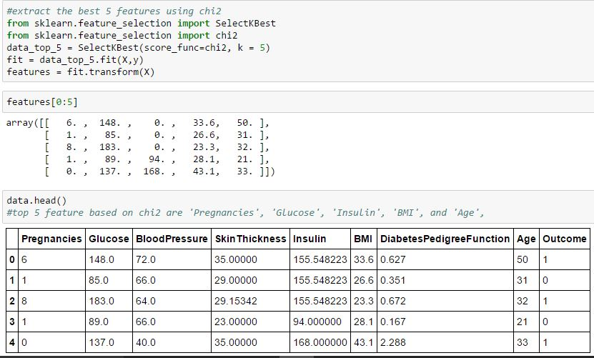
Feature Selection
Chi2: This involved selecting the 5 best features (out of the eight) that is useful in explaining the target variable.
PCA: PCA was used to develop 2, 4, 5, 6 and 7 principal components to test the various models.
Fig 3: Code & result of
feature selection using
chi2

Slide 8
Model Building & Selection
Model Building & Selection Approach
1. Logistic Regression on the 5 chi2-Selected Features
2. KNN on the 5 chi2-Selected Features
3. Logistic Regression on 6 Principal Components
4. Logistic Regression on 5 Principal Components
5. Logistic Regression on 4 Principal Components
6. Determine Accuracy Score for Each Model
7. Select the Best Model Based on Accuracy Score
8. Determine Null Accuracy & Compare With Selected Model

Slide 9
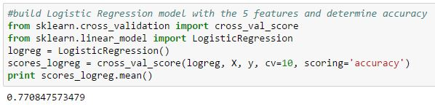
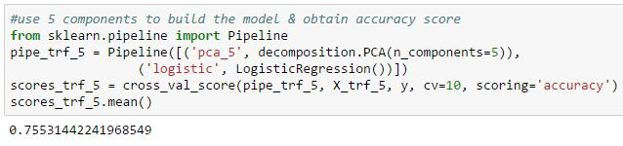
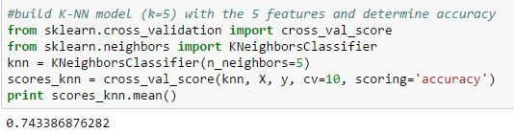
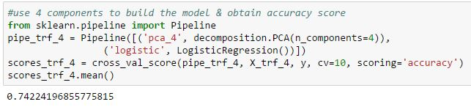
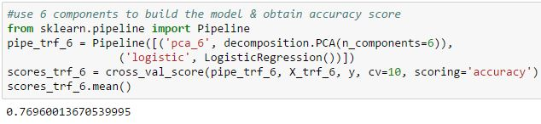
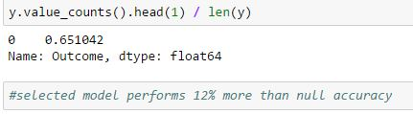
Model Building & Selection (cont’d)
Fig 4: Logistic Regression on the 5 chi2-Selected Features
Fig 5: KNN on the 5 chi2-Selected Features
Fig 6: Logistic Regression on 6 Principal Components
odel
Fig 7: Logistic Regression on 5 Principal Components
Fig 8: Logistic Regression on 4 Principal Components
Fig 9: Null Accuracy

Slide 10
Conclusion
Best Model
The best model was the Logistic Regression based on the 5 Features Determined by the chi2, with a performance of 77.08% Accuracy
Chosen Model outperformed Null Accuracy by more than 12%
5 Feature on Which Model is Based are 'Pregnancies', 'Glucose', 'Insulin', 'BMI', and 'Age'
Next Steps
Apply the 3 Unused Features to Build Models and Compare Accuracy Score with the Chosen Model
Use Model Ensemble & Confirm if Accuracy Score Will be Better Than the Chose Model
Explore if Python Packages Can Help in Determining the Significance of the Individual Features on the Classification Result in order to Influence Real-Life Intervention Strategy

